Slide 1


Make In India
Magnetic
Industries

Slide 2
Make In India
Design, Manufacture & Supply of all types of
High Mast Systems, Street Light Octagonal Poles & Its Control Panel

Slide 3

These sturdy and corrosion resistant products are provided with premium quality. In order to maintain flawless production, we have a team of qualified and well-versed professionals. Our growth and success have been directly attributed to our team of professional and experienced staff. We have state-of-the-art infrastructure equipped with high definition advance technology. Our company has employed knowledgeable quality analysts who conduct extensive spectrum test on varied Government standard parameters.
Make In India
We are the Manufacturers of street light Poles, High mast Motorized poles, Octagonal Poles, conical poles, smart city poles, structural towers, stadium masts, flag masts, decorative poles, Road side safety barriers, all types of street light brackets, foundation bolts and all types of accessories. All our products supplied are totally treated with Hot Deep Galvanized.
About Us:

Slide 4


Our Vision
Make In India

Slide 5

Our Products
Make In India
Accessories:
Foundation Bolt
Brackets: Sword, Round Type
Electrical Connections
Single/Double Arm
Erection
Decorative Brackets
Timer/Photo Cell
Pole Box/FRP/ Terminal
Luminaries- LED/ HPSC/DPSC/ MV
Poles
High-mast Lighting System
Octagonal & Conical Street Light Pole
Swaged Pole
Structural Tower
Decorative Poles
Flag Mast
Solar Streetlight Poles & High-masts
Multipurpose poles

Slide 6


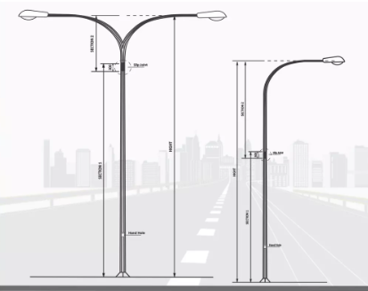
Street Light
Poles
Make In India

Slide 7
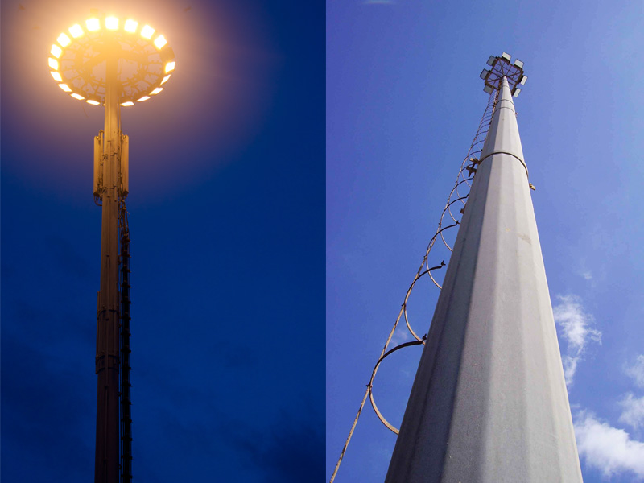
Structural Towers
Make In India

Slide 8
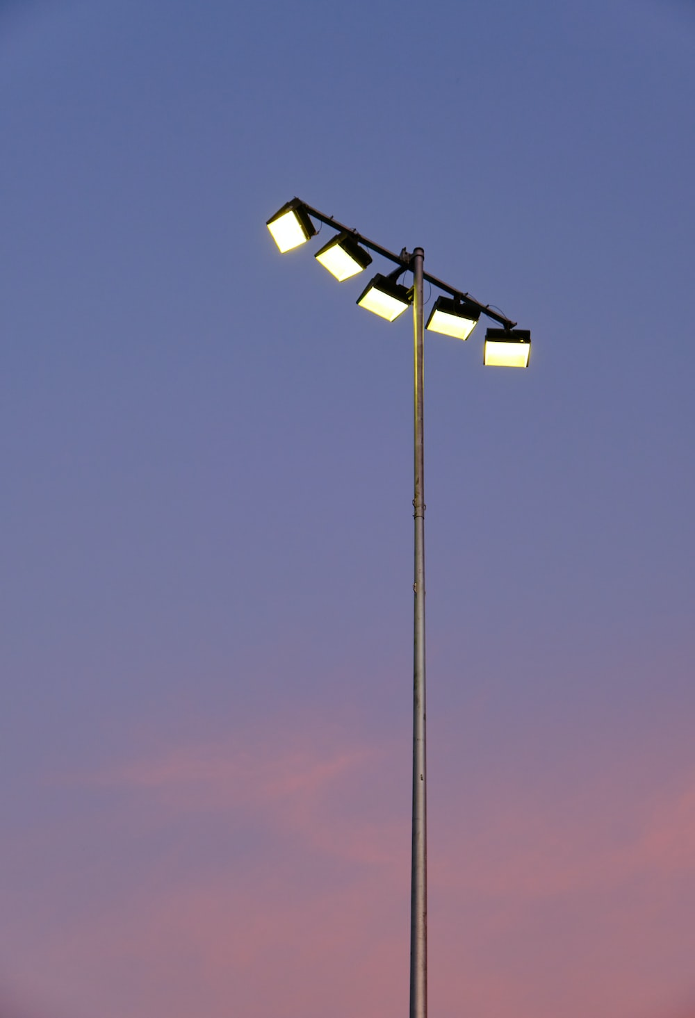
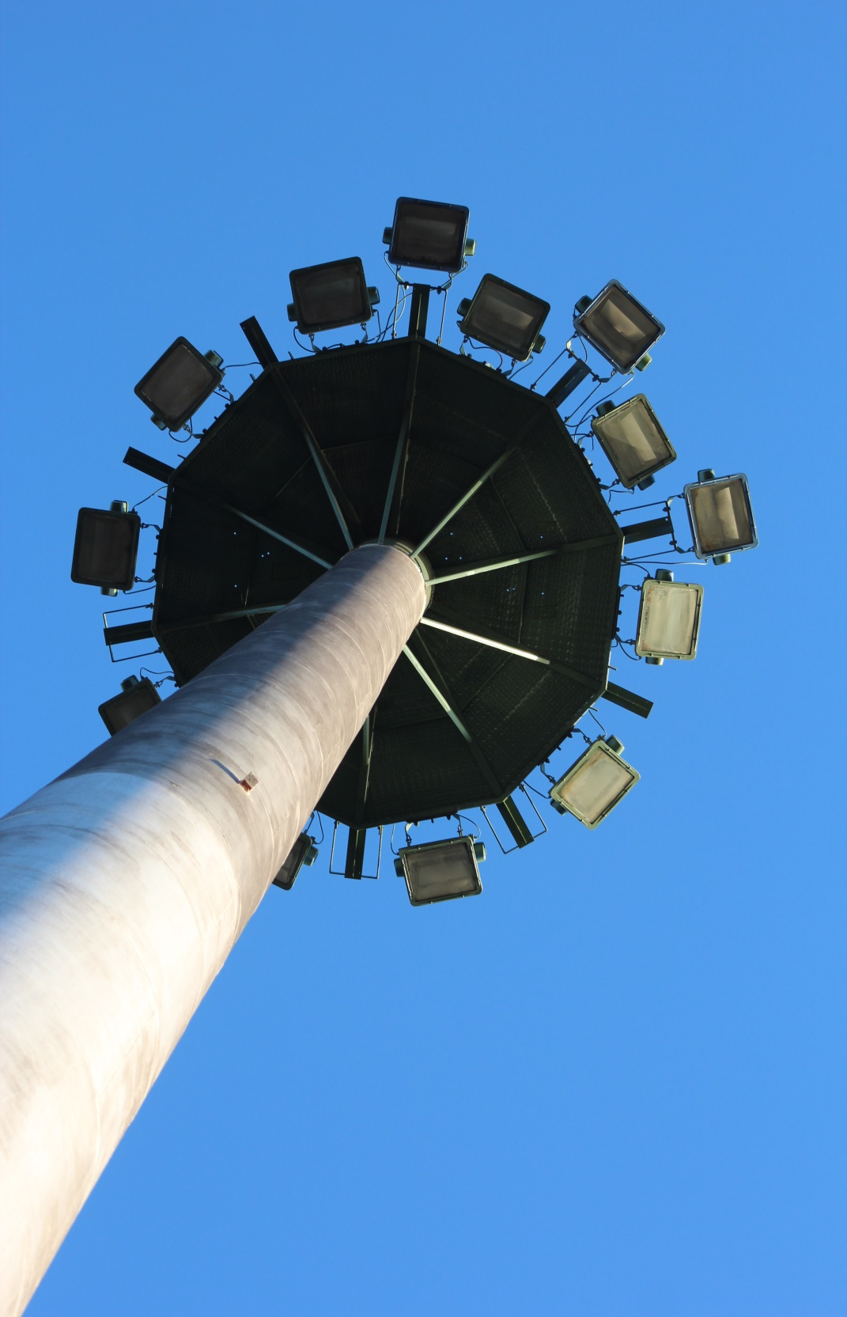
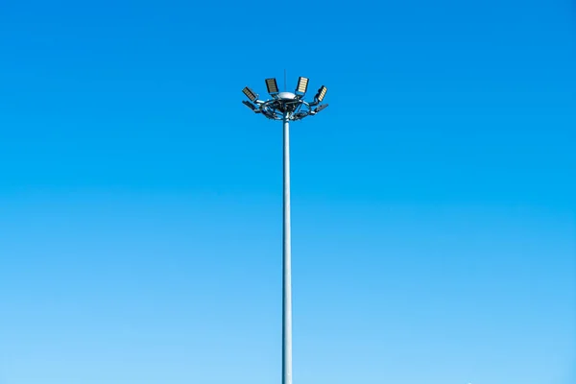
Stadium High Mast
Make In India

Slide 9

Octagonal Poles
Make In India
Area of application
Highways Lights
Street Lights
Solar Street Lights
Structural Tower
Parking
Traffic Light system
CCTV Cameras

Slide 10

Make In India
Flag Mast
We are affianced in manufacturing and supplying a wide assortment of Flag mast Poles.

Slide 11
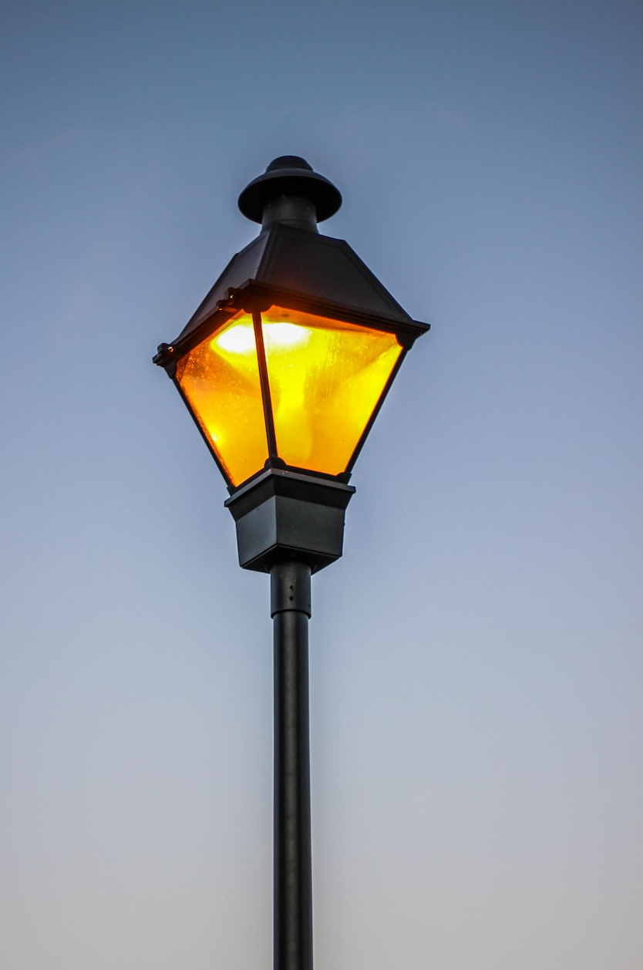

Decorative Pole
Make In India

Slide 12


Make In India
Solar Streetlight
Poles

Slide 13

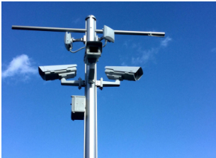
Make In India
Multipurpose
Poles

Slide 14
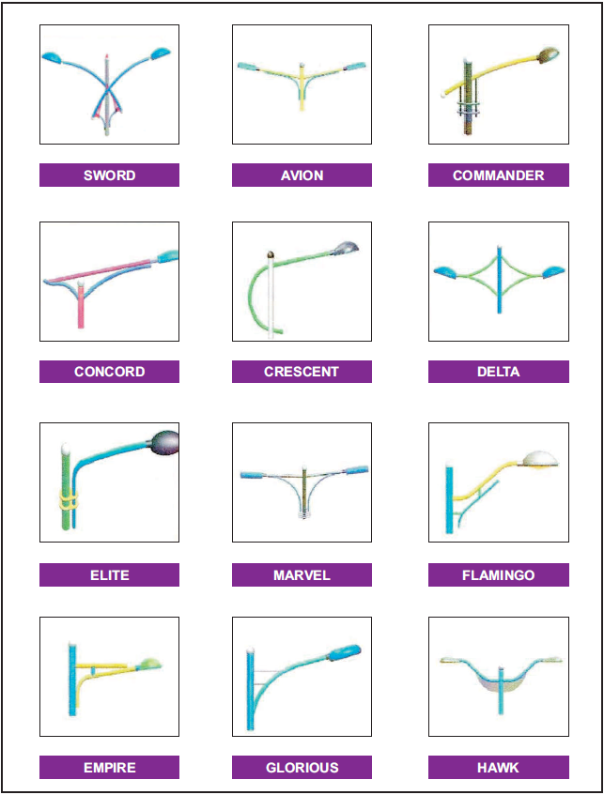
Make In India
Various Types
of Brackets

Slide 15
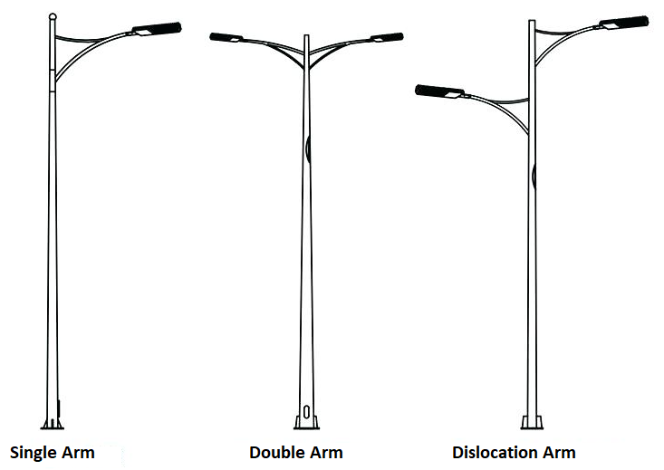
Types of Arms
Make In India

Slide 16
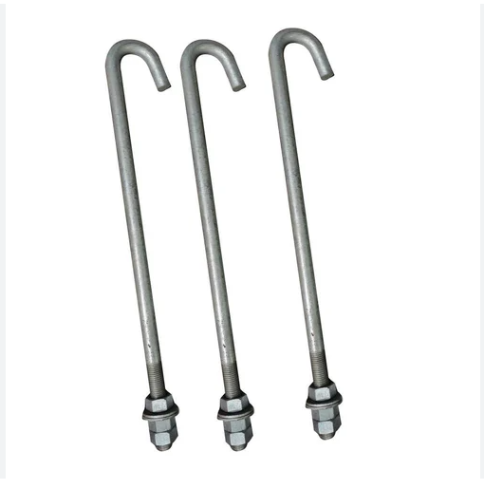
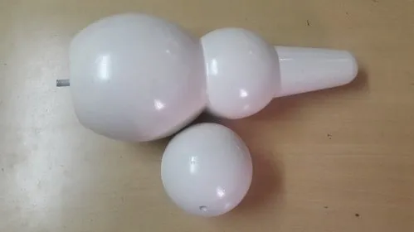
Make In India
Foundation Bolts
Decorative Parts
(Dome ball)

Slide 17
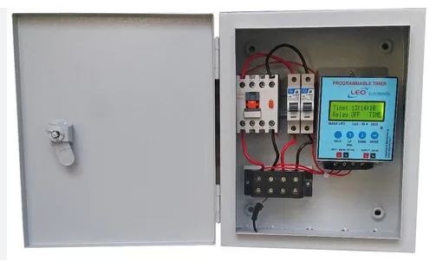
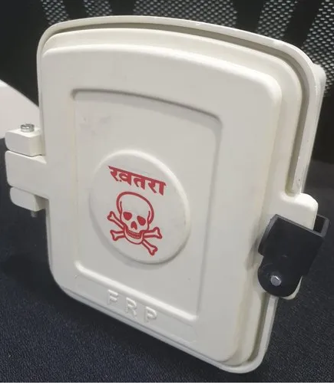
Make In India
Control Panel
FRP

Slide 18
Approved By
Make In India
Government of Maharashtra (PWD)
MSME Registered
ISO 9001:2008, 14001:2015, 18001:2007
Make in India, MOU with Government
MIDC corporation Pune

Slide 19
Contact:
Make In India
Magnetic Industries
Mr. Shivaji Shirsat (CEO)
Mob: 9420622790, 9545509770
Email: shivajimagnetic@gmail.com
Head Office
Nutan Colony, KPS Road, Aurangabad
431201, Maharashtra
Manufacturing Unit :
D-180, Five Star MIDC, Shendra, Aurangabad
Pin 431207, MH

